Slide 1





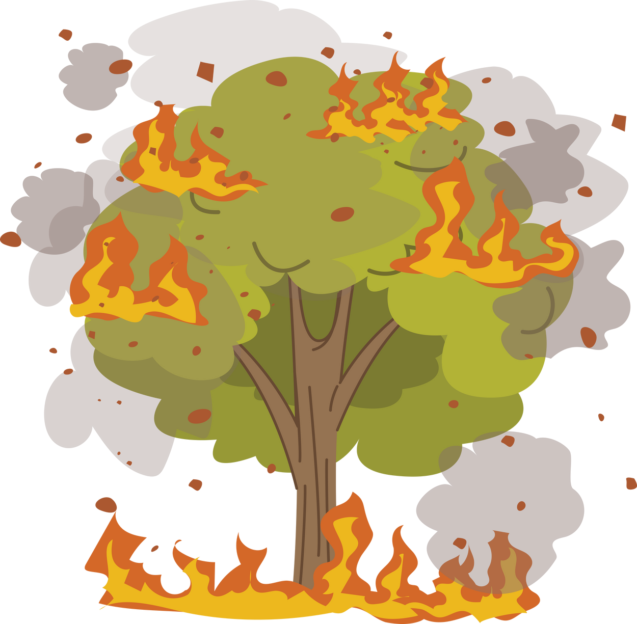
GLOBALBLAZE: ANALYZING GLOBAL TRENDS IN WILDFIRE BURNED AREAS AND EMISSIONS (2002-2023)
PUNEETHA DHARMAPURA SHRIRAMA
Notes:
“Hello everyone. My name is Puneetha, Imagine a world where wildfires shape our environment and future. Let's dive into the story with: 'GLOBALBLAZE: Analyzing Global Trends in Wildfire Burned Areas and Emissions from 2002 to 2023.. Let’s look into the agenda and see what are the topics we are going to discuss

Slide 2

AGENDA
1. Introduction
2. Data Sources
3. Data Pipeline
4. Results
5. Conclusion
6. Limitations
Notes:
"We'll start with an Introduction, followed by a look at our Data Sources and the Data Pipeline we used. Next, we'll explore the Results, and then move to the Conclusion and Limitations of our study. Let's get started with the Introduction."

Slide 3
Introduction

Slide 4
Wildfires are a major environmental challenge.
Influence on climate change and air quality.
Objectives:
Analyzing long-term trends.
Examining seasonal variations.
Identifying regions with the most wildfires.
Correlation between wildfire area burned and emissions.
Notes:
"Wildfires are one of the major environmental issue while these impact on climate change and air quality. Objective of this project is to analyze long-term trends in wildfire burned areas and emissions, to examine seasonal variations means in which months the wildfires are more, and also to identify which regions affected the most at last we have correalation between burned area and emsisions."

Slide 5

Data Sources

Slide 6
Global Wildfire Information System (GWIS) [2002-2023]
Global Monthly Burned Area Dataset (GMBAD) :
This Dataset contains details about monthly burned area records for different countries and landtypes. Land types are measured in hectares.
Global Monthly Emission Dataset (GMED) :
It Contains monthly burning emissions by different pollutants and countries. Pollutant gases are measured in tons.
Data source : Global Wildfire Information System (https://gwis.jrc.ec.europa.eu/apps/country.profile/downloads)
Notes:
"We used data from the Global Wildfire Information System (GWIS) from 2002-2023, the first dataset is Global Monthly Burned Area Dataset as the name suggests we have monthly burned area records with different countries and also the landtypes such as forest, savannas, shrubs grasslands , croplands and other areas.and the second dataset i.e Global Monthly Emission Dataset it contains monthly emissions recorded with different pollutants like Co2,Carbon monoxide, total particulate matter and many more "

Slide 7
Data Pipeline

Slide 8
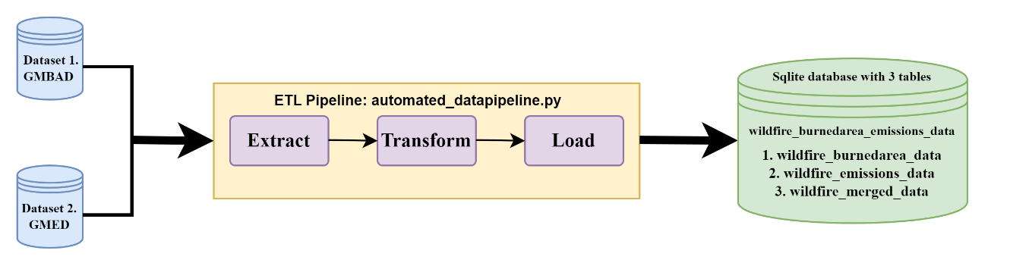
Figure 1 : ETL Pipeline Flowchart
Notes:
"Here's a visual representation of our ETL, Extraction: we have used Python’s request library to fetch ZIP files from the website, then extracts their content into memory for further processing and analysis.
During transformation, both burned area and emissions data are cleaned by removing irrelevant columns, filtering out rows with zero values, renaming columns, and also added a quarter column for seasonal analysis.
After transformation, data is stored in an SQLite database for storage and analysis.

Slide 9
Results

Slide 10
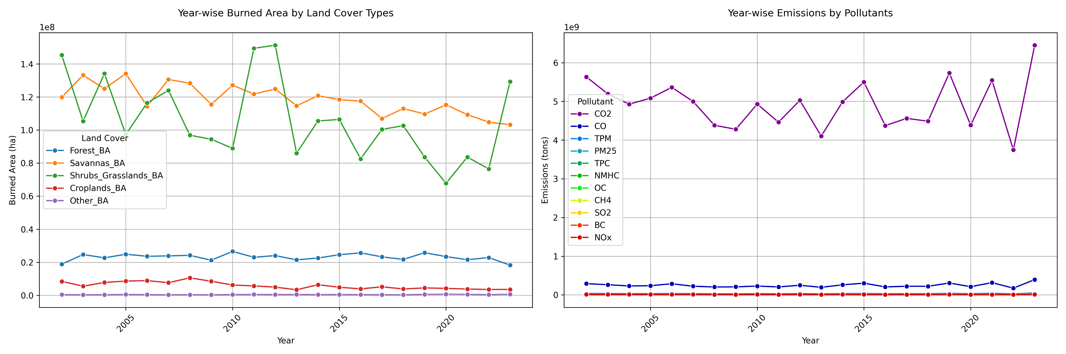
Long-term Trends
Figure 2 : Year-Wise Burned Area and Emissions
Notes:
Now, let's look at the long-term trends. This figure shows the year-wise burned area and emissions. From both the charts we can say that There's a slight decline over time, likely due to improved land care and climate change. CO2 emissions show fluctuations with peaks and troughs, indicating wildfire intensity.

Slide 11
Insights:
Stable wildfire patterns in forests due to effective fire management.
High burned areas are shrubs, grasslands, and savannas.
Slight decline over time due to improved land care and climate change.
CO2 emissions show fluctuations with notable peaks and troughs.
Notes:
forest fire patterns have remained relatively stable due to effective fire management, we see high burned areas in shrubs, grasslands, and savannas

Slide 12
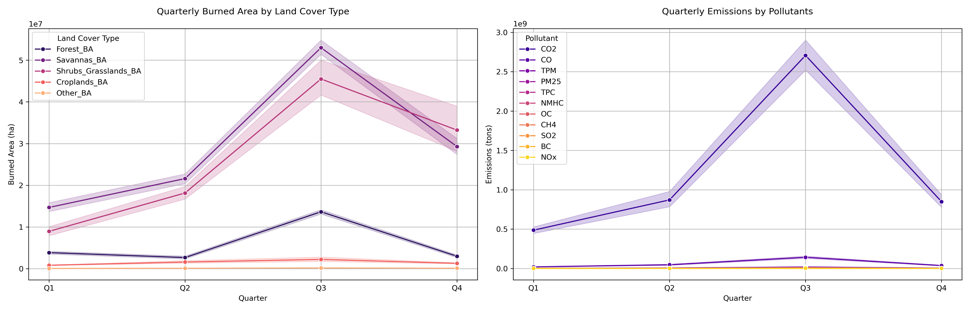
2. Seasonal Variations
Figure 3 : Quarterly Burned Area and Emissions
Notes:
Examining seasonal variations, we observe that burned areas and emissions increase from the first quarter to the third quarter, peaking in the summer months from July to September. In the fourth quarter, there's a noticeable decrease

Slide 13
Insights:
Burned area and emissions increase from Q1 to Q3, peaking in Q3 (July to September).
High temperatures and low humidity in summer.
Human Activities
Noticeable decrease in Q4 due to late autumn to early winter.
Notes:
Let‘s see the reasons behind that

Slide 14
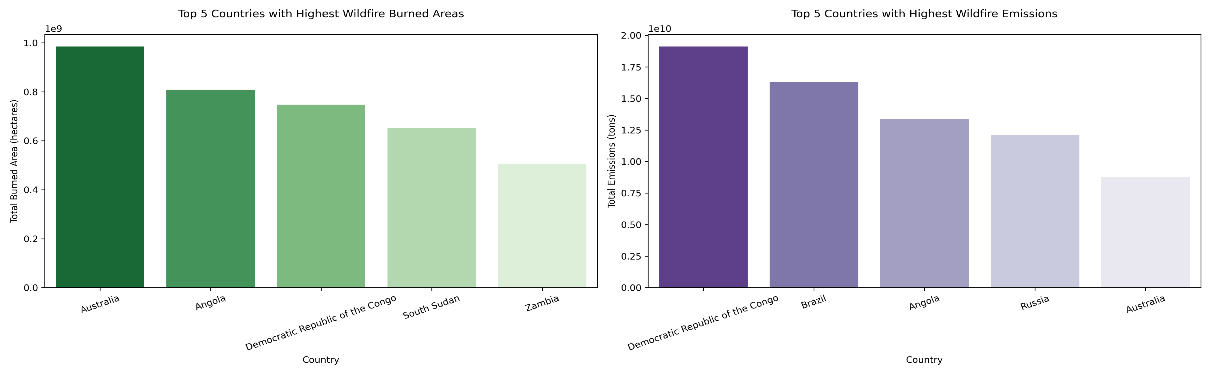
3. Top Countries Affected by Wildfires
Figure 4 : Top Countries affected by Wildfires
Notes:
Here, we see the countries most affected by wildfires. Australia faces frequent wildfires. countries like Angola, the Democratic Republic of the Congo, South Sudan, and Zambia belongs to Africa. in emissions chart we can see that brazil and Russia is contributing to highest emissions but not burned area. Lets see the reason for that

Slide 15
Insights:
Australia: Dry Climate and drought conditions.
Angola, Democratic Republic of the Congo, South Sudan, Zambia : Extensive savannas and grasslands.
Brazil has amazon rainforest
Russia has Siberian and boreal forests contains large amount of carbon-rich peat and organic soils.
Notes:
In Brazil's Amazon Rainforest, fires may not cover vast areas but are highly intense, resulting in more emissions. Meanwhile, Russia's Siberian and boreal forests contain carbon-rich peat and organic soils. Fires in these regions can penetrate deeply into the ground, releasing significant carbon dioxide and other pollutants, despite not always covering extensive surface areas

Slide 16
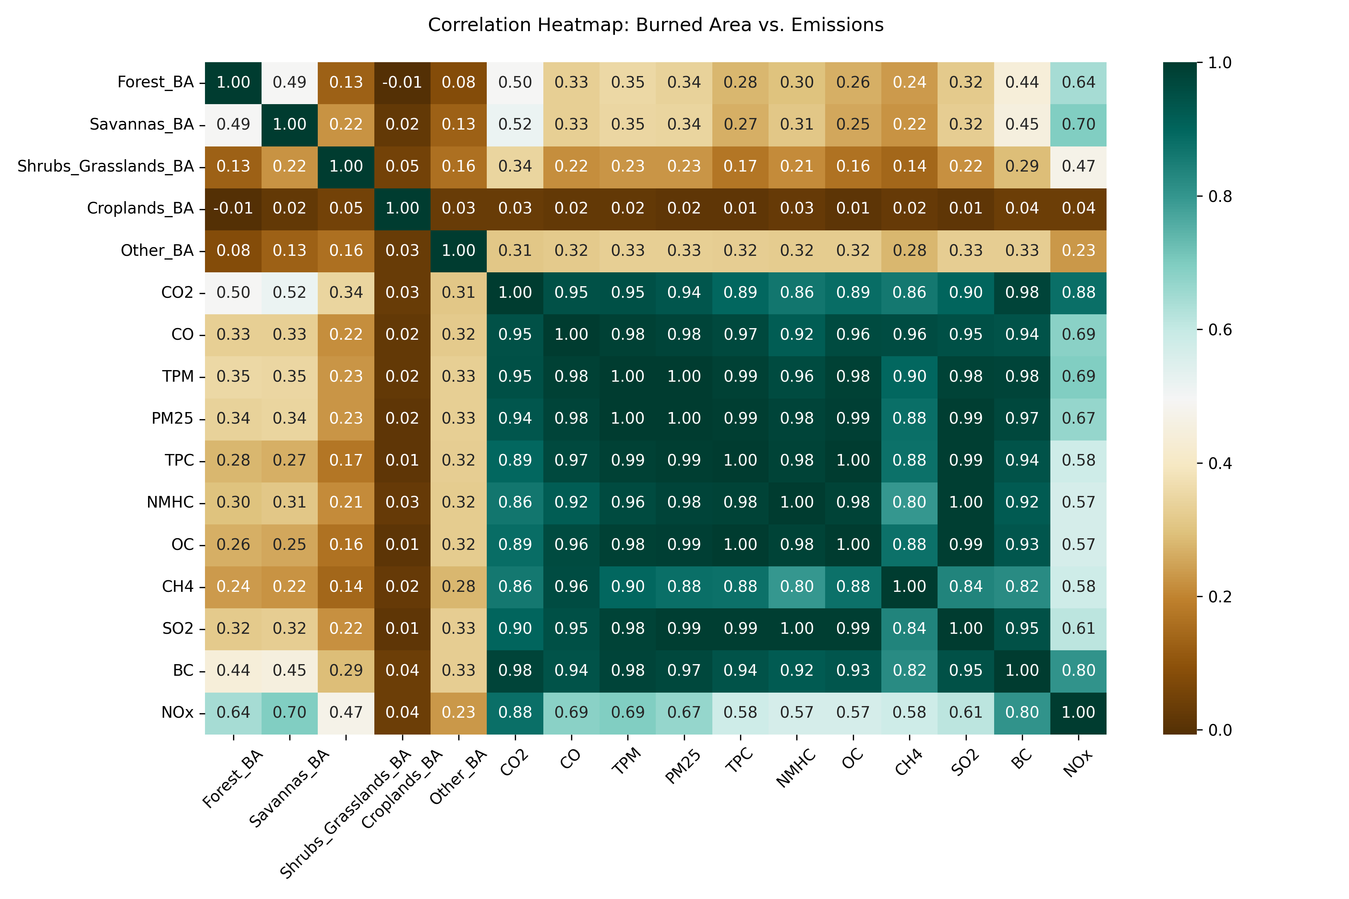
4. Correlation between Burned Area and Emissions
Figure 5 : Correlation between Burned Area and Emissions
Notes:
This slide shows the correlation between burned area and emissions. Our analysis reveals a strong correlation, particularly in forests and savannas, which are major contributors to CO2, CO, TPM, and NOx emissions. Interestingly, croplands have the least impact on emissions.

Slide 17
Insights:
Emissions are highly correlated with each other.
Reducing one type of emission helps to decrease others.
Forests and savannas are significant contributors to CO2, CO, TPM, and NOx emissions.
Croplands have the least impact on emissions.
Notes:
Emissions are highly correlated with each other.
Reducing one type of emission helps to decrease others.

Slide 18
Conclusion

Slide 19
To Conclude..
Savannas and shrub grasslands are more prone to wildfires.
Wildfires are peak in summer months (July to September).
Strong correlation between burned area and emission gases, particularly CO2 and NOx.
Effective fire management practices and targeted emission reduction strategies are crucial.
Notes:
To conclude, our study shows that savannas and shrub grasslands are more prone to wildfires, which peak during the summer months. And also There's a strong correlation between burned areas and emission gases, especially CO2 and NOx. It's important to use good ways to manage fires and focus on reducing emissions to reduce the impact of wildfires. At last lets see the limitations with respect to the datasets

Slide 20
Limitations

Slide 21
Limitations for Datasets
1. Does not fully explore all factors contributing to wildfires.
2. Monthly data aggregation may overlook detailed temporal variations.
Notes:
The analysis doesn't cover all the reasons why wildfires happen, like human actions, changes in how land is used, and certain weather conditions like temperature. Also, because the data is put together every month, it might miss out on smaller changes day-to-day or week-to-week, and sudden increases in wildfires caused by extreme weather or human actions might not show up well in the monthly averages.

Slide 22
THANK YOU ☺
Puneetha Dharmapura Shrirama
https://github.com/puni-ram48/MADE-SS2024
Notes:
Thank you for your attention. For more information, you can visit my GitHub at https://github.com/puni-ram48/MADE-SS2024

